Slide 1





24 Hour Hackathon
SUBSECTION ROUND
Team Name:
Team Leader's Name:
Team Members:
Institution:

Slide 2

Format
  Heading Font: Open Sans, 32, Bold
  Table content font: Open Sans, 22, Normal
  Normal Slide content font: Open Sans, 26, Normal

Slide 3
Problem Statement
  Title: What are we solving?
  Describe the real-world challenge clearly in 2–3 lines.
  Add a simple icon/illustration of the problem.
  Highlight the urgency/relevance.

Slide 4
Motivation & Importance
  Why this problem matters.
  Who is affected? (target audience/industry).
  2–3 supporting stats or short facts (use infographic style).
  Keep text minimal → one big problem insight.

Slide 5
Proposed Solution
  Your idea/solution in one strong statement.
  Flow diagram or simple illustration.
  Key features (3–4 bullet points).
  Make it visually striking (big bold solution statement).

Slide 6
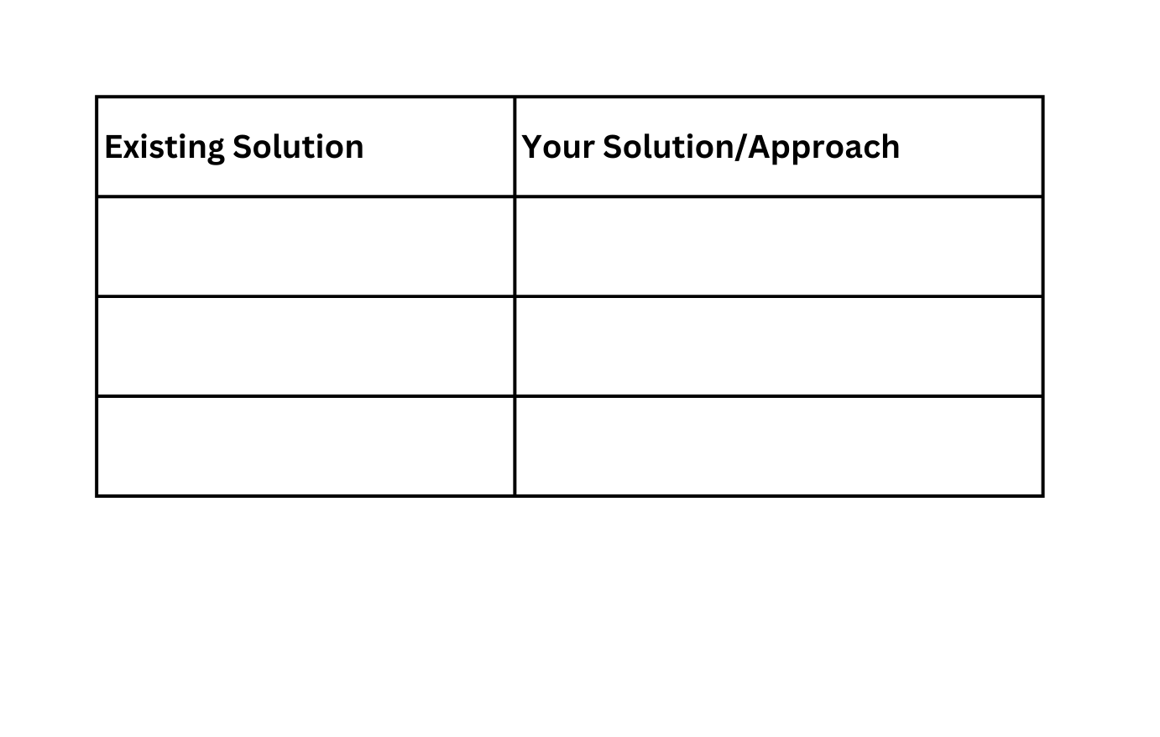
Innovation & Uniqueness
  What makes your idea different from existing solutions?

Slide 7
Implementation Plan
  High-level roadmap:
Phase 1: Research & Design
Phase 2: Development
Phase 3: Testing & Deployment
  Timeline (a simple horizontal infographic).
  Mock prototype / Demo (optional)

Slide 8
Impact & Benefits
  Social / Economic / Technological impact.
  Who will benefit? (students, industries, society).
  Keep 3–4 crisp points + icons.

Slide 9
Team & Conclusion
  Team intro (names + roles).
  Mentor/Institution acknowledgment.
  One-liner “Why our idea deserves to win”.
  Contact info (email/LinkedIn/handles).

